Slide 1
What is input layer:
Input layer in CNN should contain image data. Image data is represented by three dimensional matrix . You need to reshape it into a single column. Suppose you have image of dimension 28 x 28 =784, you need to convert it into 784 x 1 before feeding into input.
Why we use the input layer:
Input layer accept the data and pass it to the rest of the network.

Slide 2
What is hidden layer:
A hidden layer in an artificial neural network is a layer in between input layers and output layers, where artificial neurons take in a set of weighted inputs and produce an output through an activation function.
Why we use hidden layer:
Hidden layers allow the neural network to learn nonlinear relationships between the input and output data. Hidden layers can extract meaningful features from the input data that can be used for prediction. Adding more hidden layers and neurons can increase the capacity of the neural network, enabling it to learn more complex patterns and relationships in the data.

Slide 3
What is output layer:
The output layer is the final layer in the neural network. There is one output layer in a neural network that produces the desired final prediction. The output layer's architecture and activation function depend on the type of problem and the desired output format. For example, in binary classification problems, the output layer may consist of a single node with a sigmoid activation function that produces a probability value between 0 and 1. In contrast, in multi-class classification problems, the output layer may consist of multiple nodes with a SoftMax activation function that produces a probability distribution over all the classes.

Slide 4
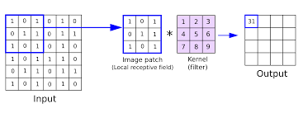
What is convolutional layer:
convolutional layer is a fundamental building block used for feature extraction from image inputs. The convolution operation involves applying a set of filters (also known as kernels or feature detectors) to the input image, which results in a set of feature maps. The filters are small, typically square-shaped. The filters slide or convolve across the input image, performing an element-wise multiplication between the filter and a small patch of the input image at a time. The resulting scalar values are summed up to produce a single output value, which is then placed in the corresponding location of the output feature map.

Slide 5
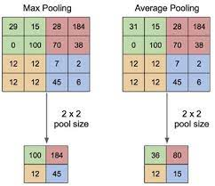
What is pooling layers:
In Convolutional Neural Networks (CNNs), a pooling layer is a type of layer that is typically used after a convolutional layer. The purpose of the pooling layer is to down sample the feature maps generated by the convolutional layer. The pooling layer is an important component of CNNs, allowing them to effectively extract and utilize the most important features from the input images while reducing the computational complexity of the network.

Slide 6
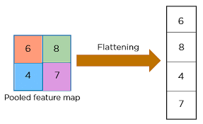
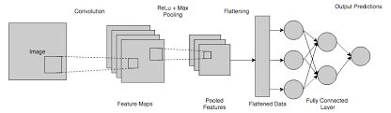
What is fully connected layer:
In Convolutional Neural Networks (CNNs), a fully connected layer (also known as a dense layer) is a type of layer that is typically used at the end of the network, after the convolutional and pooling layers. In a fully connected layer, each neuron computes a weighted sum of the input values from the previous layer and passes the result through an activation function. The weights of the connections between the neurons are learned during the training process, along with the other parameters of the network.
The purpose of the fully connected layer is to take the high-level features that have been extracted from the input image by the convolutional and pooling layers and use them to classify the image. The fully connected layer can take as input a vector of fixed size, which is achieved by flattening the output of the preceding convolutional and pooling layers.

Slide 7
What is activation function:
An Activation Function decides whether a neuron should be activated or not. This means that it will decide whether the neuron's input to the network is important or not in the process of prediction using simpler mathematical operations.
Why we use activation function:
Activation functions play an integral role in neural networks by introducing nonlinearity. This nonlinearity allows neural networks to develop complex representations.

Slide 8
Types:
Binary step activation function
Sigmoid activation function
TanH activation function
Relu activation function
SoftMax activation function

Slide 9
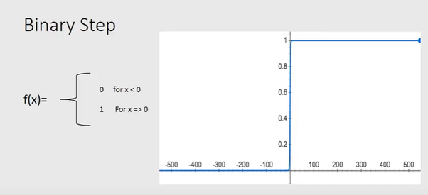
Binary step activation function:
The output of binary step is 1 or 0.whenever we want to have output in the form of 0 or 1.Then we use binary step activation function.
If output is greater than threshold value than output is 1.
If output is less than threshold value than output is 0.

Slide 10
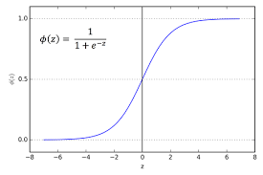
Sigmoid activation function:
Whenever we want output in the range of 0 to1 then we use sigmoid activation function. This is mainly used in binary classification problems. This sigmoid function gives the probability of an existence of a particular class. The number e is a mathematical constant that is the base. It is approximately equal to the 2.71828.

Slide 11
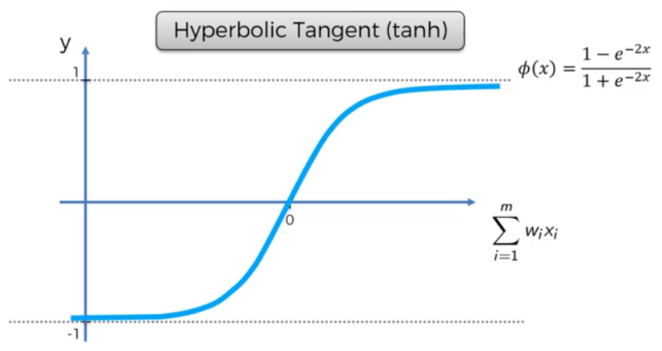
Tanh activation function:
Tanh(x) gives the hyperbolic of the tangent of x. unlike sigmoid function the range of tanh is -1 to +1.The advantage of tanh is that we can deal negative numbers.

Slide 12
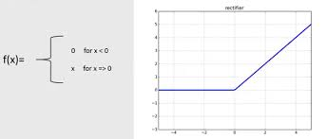
Relu activation function:
Relu is the popular function most of the time we use relu only. This relu function converts the negative values to 0.It can remove the negative values.
F(x)=max(0,x)

Slide 13
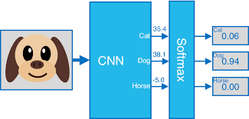
SoftMax activation function:
It is used in classification problems. when we have multiple classes then we use SoftMax function.it will tells us probability of each class and we can find the class with the highest probability.

Slide 14
What is regularization methods :
Regularization methods are techniques used in machine learning to prevent overfitting of the model. Overfitting occurs when a model is trained on a limited set of data and then performs poorly on new, unseen data. Regularization methods add additional constraints to the model, which helps to reduce overfitting and improve its ability to generalize to new data.
Methods:
L1 regularization method or Lasso
L2 regularization method or Ridge
Dropout layer

Slide 15
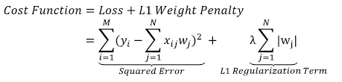
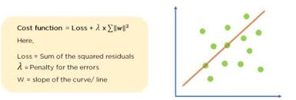
L1 regularization:
L1 Regularization, also called a lasso regression, adds the “absolute value of magnitude” of the coefficient as a penalty term to the loss function.

Slide 16
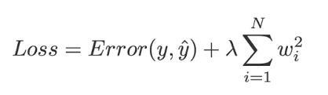
L2 regularization:
L2 Regularization, also called a ridge regression, adds the “squared magnitude” of the coefficient as the penalty term to the loss function.

Slide 17
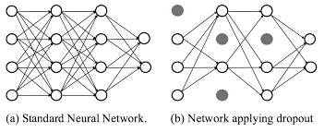
Drop out layer:
Dropout is a regularization technique used in deep learning neural networks to prevent overfitting and helps to reduce the complexity of the model. It also encourages the network to learn more robust features that are useful for making predictions on new, unseen data. During training, each neuron in the dropout layer has a probability p of being "dropped out," or set to zero. The probability p is typically set to a value between 0.2 and 0.5.

Slide 18
What is optimizers:
Optimizers are algorithms or methods used to change the attributes of your neural network such as weights and learning rate in order to reduce the losses. Optimizers help to get results faster.
Types:
Batch Gradient Descent
Stochastic Gradient Descent
Mini-batch gradient descent

Slide 19
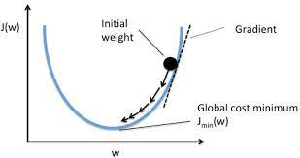
What is gradient:
A gradient is a derivative of a function that has more than one input variable. Known as the slope of a function in mathematical terms, the gradient simply measures the change in all weights with regard to the change in error.

Slide 20
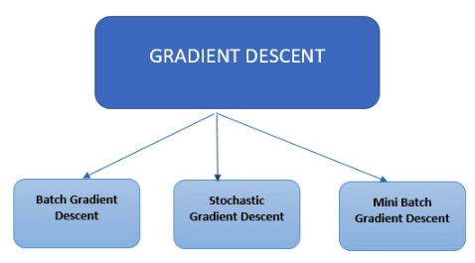
What is gradient descent:
Gradient descent is an optimization algorithm commonly used in neural networks to train the network and minimize the loss function. The goal of gradient descent is to find the weights and biases of the network that minimize the difference between the predicted output of the network and the true output.

Slide 21
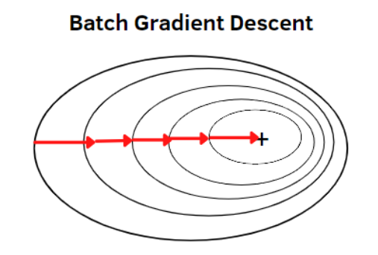
What is batch gradient descent:
In Batch Gradient Descent, the entire dataset is used to compute the gradient of the loss function. We take the average of the gradients of all the training examples and then use that mean gradient to update our parameters. So that's just one step of gradient descent in one epoch. batch gradient descent can be computationally expensive and may require a large amount of memory to store the entire training dataset in memory. It can also take a long time to compute the gradient on large datasets, especially if the model is complex or has a large number of parameters.

Slide 22
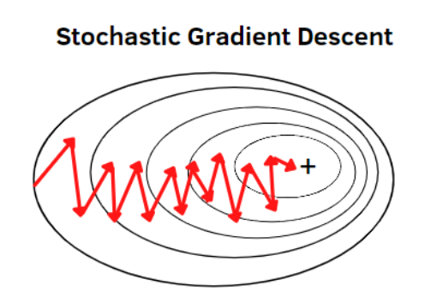
What is stochastic gradient descent:
In stochastic gradient descent, a single data point is used to compute the gradient. The basic idea of stochastic gradient descent is to randomly select a single training sample from the dataset and compute the gradient of the loss function with respect to the model parameters using only that sample. The gradient is then used to update the weights and biases of the model in the direction of the negative gradient, which minimizes the loss function. It can be much faster and more computationally efficient, especially on large datasets, since it only computes the gradient using a single sample at a time

Slide 23
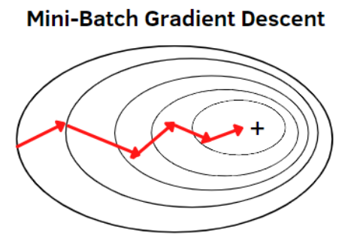
What is mini batch gradient descent:
In mini-batch gradient descent, smaller batches of the data are used to compute the gradient. It combines the ideas of batch gradient descent with SGD, it is the preferred technique. It divides the training dataset into manageable groups and updates each separately.
Mini-batch gradient descent can be much faster and more computationally efficient than batch gradient descent, especially on large datasets. It can lead to smoother and more stable convergence compared to stochastic gradient descent.

Slide 24
What is vanishing gradient problem:
Vanishing gradient problem occur during the training neural networks. During backpropagation, the gradient of the error with respect to the weights in the network is calculated and used to update the weights. However, in deep networks with many layers, the gradient can become very small as it is propagated backward through the layers. This is because the gradient is multiplied by the weight matrix at each layer, and if the weights are small, the gradient can shrink to almost zero.
When the gradient becomes very small, the weights in the early layers of the network are not updated significantly, which can result in slow convergence. This is known as the vanishing gradient problem.

Slide 25
What is exploding gradient problem:
The exploding gradient problem, can also occur, where the gradient becomes too large and causes the weights to update too much, making the training unstable. Both the vanishing and exploding gradient problems can make it difficult to train deep neural networks effectively.

Slide 26
What is loss function:
A loss function in neural networks is a mathematical function that measures the difference between the predicted output and the true output of the training data. The goal of a neural network is to minimize this difference or error to improve the accuracy of the model.
Whenever you provide batch of records and you get error then it is called as cost function.
Whenever you provide one record at a time and do forward propagation then you get error that is loss function.
Classification error types:
Binary cross entropy
Categorical cross entropy
Sparse categorical cross entropy

Slide 27
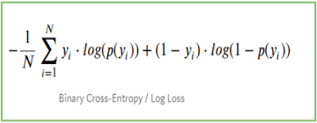
Binary cross entropy:
Binary cross entropy is a loss function used in neural networks for binary classification problems, where the goal is to predict a binary output (0 or 1). It is a measure of the difference between the predicted output and the true output of the training data.
-log(1-yhat) --→ if y=0
-log(yhat) ---→if y=1

Slide 28
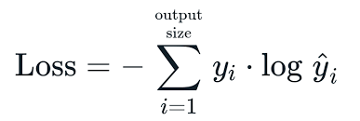
Categorical cross entropy:
Categorical cross entropy is a loss function used in neural networks for multi-class classification problems, where the goal is to predict a categorical output (one of several possible classes). It is a measure of the difference between the predicted output and the true output (labels) of the training data.

Slide 29
Sparse categorical cross entropy:
Sparse categorical cross entropy is a loss function used in neural networks for multi-class classification problems, where the goal is to predict a categorical output (one of several possible classes) but the true output is represented as an integer rather than a one-hot encoded vector.
Sparse categorical cross entropy is used when the number of classes is large and creating a one-hot encoded vector for each sample in the training data would be computationally expensive or memory-intensive.
If your actual y values are one hot encoded, use categorical cross entropy. Example for a 3 class classification:[1,0,0],[0,1,0],[0,0,1]
If your actual y values are integers, use sparse categorical cross entropy. Example for a 3 class classification:[1],[2],[3]

Slide 30
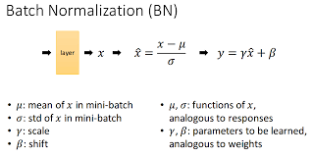
What is batch normalization:
Batch normalization is a technique used in deep learning to improve the training process and performance of neural networks. The mean and variance of the inputs to each layer are computed over a batch of training examples, and these statistics are used to normalize the inputs. This helps to reduce the internal covariate shift.
An internal covariate shift occurs when there is a change in the input distribution to our network. When the input distribution changes, hidden layers try to learn to adapt to the new distribution. This slows down the training process. If a process slows down, it takes a long time to converge to a global minimum.

Slide 31
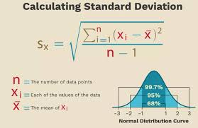
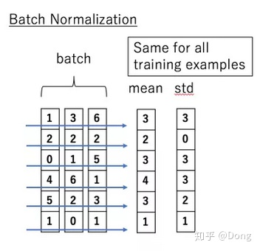
Why we use batch normalization:
Improved training speed: Batch normalization helps to speed up the training process by reducing the internal covariate shift, which can cause the network to converge more slowly or not converge at all. By normalizing the inputs to each layer, batch normalization allows the network to learn more quickly and efficiently.
Gradient propagation: Batch normalization can help to address the problem of vanishing or exploding gradients, which can occur in deep neural networks. By normalizing the inputs to each layer, batch normalization can help to ensure that the gradients propagate through the network more smoothly and prevent the gradients from becoming too small or too large.

Slide 32
What is weight initialization:
Weight initialization is a crucial step in the training of neural networks. The goal of weight initialization is to set the initial values of the weights in such a way that the network can learn efficiently and effectively.
Why we use weight initialization techniques:
Avoiding saturation and exploding gradients: The gradients can become very small or very large during the training of neural networks, making it difficult for the network to learn effectively. Weight initialization techniques can help prevent these problems by setting the initial weights in a way that ensures that the gradients neither vanish nor explode.
Speeding up convergence: Proper initialization of weights can help the network converge faster during training, thus reducing the time required to train the network.

Slide 33
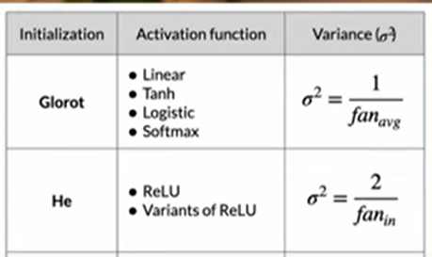
He initialization:
He initialization is a useful technique in deep learning because it helps ensure that the network can learn effectively and efficiently, especially when using ReLU activation functions. By setting the initial weights appropriately, it can help prevent the vanishing gradient problem and improve the performance of the network.
Xavier Glorat initialization:
Xavier Glorat initialization also used to prevent the vanishing gradient problem,especially when using Tanh and sigmoid.

